Slide 1
Visualization of Global BMI Trends: Investigating the Covariance of BMI,
Alcohol, and Geography
Bruce Chen, Guan Chen, Ashleigh Frank
Notes:
Trends of increasing obesity remain resilient with approximately 40% of American adults being obese. The factors contributing to high Body Mass Index (BMI) are diverse and highly nuanced.
For example, people in lower socioeconomic classes are more likely to consume less nutritious foods, increasing the likelihood of a higher BMI. Alcohol consumption is another factor that may increase BMI due to the empty calories it provides while stimulating appetite and promoting fat accumulation.

Slide 2
backgrounds
Notes:
Good evening everyone!
I’m Bruce, and I’ll start by introducing the background of our project.

Slide 3
Context
Notes:
Let’s begin with one simple thing — food.

Slide 4
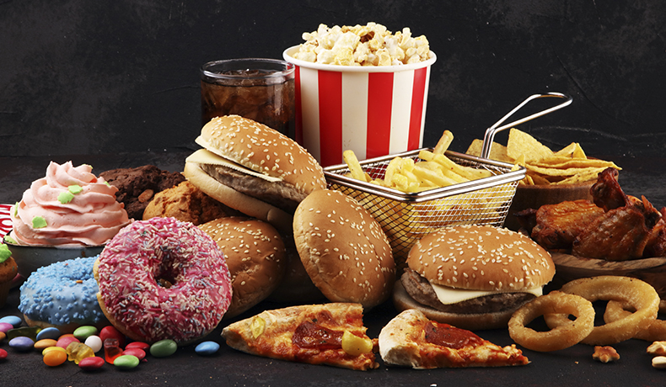
Context
Notes:
In America, food is fast, convenient, and cheap…
but obviously — it’s also very unhealthy According to the CDC, about 40% of American adults are obese today.
So the problem has shifted —
{from “How can we get enough to eat?”
to “How can we eat healthy?”}

Slide 5
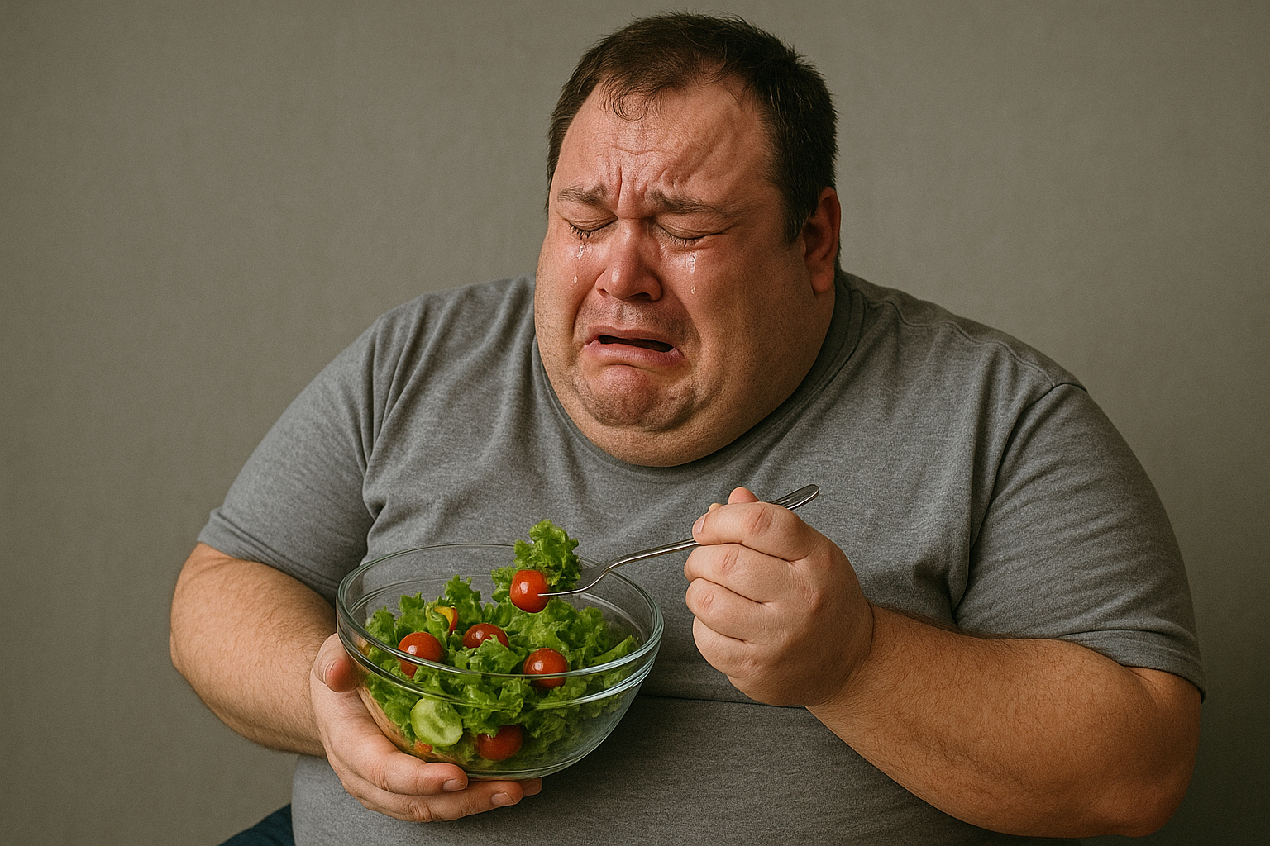
Context
Notes:
{from “How can we get enough to eat?” to “How can we eat healthy?”}
Now you might think,
“Okay, so just eat healthier, right?”
Nah, not that easy.
if we really want to understand this issue,
we need to look deeper — the problem is way more {complex than we expect.}

Slide 6
Complexity
Notes:
Obesity isn’t just about eating habits.
{It’s affected by a whole mix of factors —
alcohol consumption, BMI, sex, income level all play a part}

Slide 7
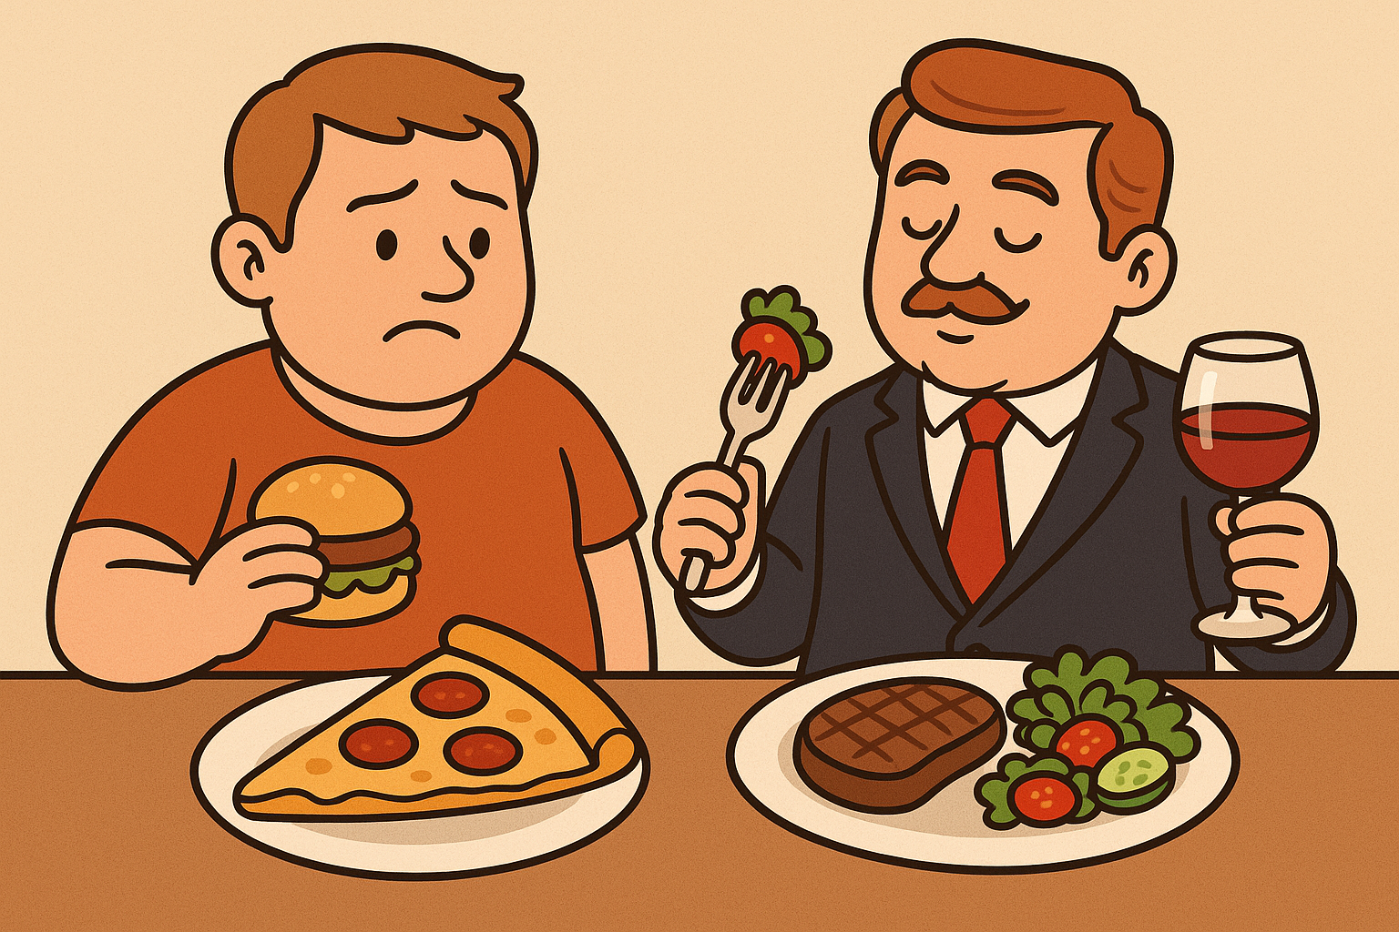
Complexity
Notes:
For example, people with lower income often buy cheaper food —
which usually means high calories and low nutrition.
That leads to poor nutrition, stronger appetite, and eventually… more weight gain.
Then comes alcohol, which makes things even messier —
it’s full of empty calories and helps your body store more fat.
{But here’s the twist —}

Slide 8
Complexity
Notes:
people with higher income actually drink more alcohol! 🍷
And guess what — men and women also show different patterns
in both drinking and body weight changes.
{So clearly, there’s a lot going on here.}

Slide 9
Research Gap
Notes:
{So clearly, there’s a lot going on here.}
These factors interact in complicated ways.
Simple statistics can’t capture the full story.
And it’s even not just an American problem —
different countries show very different patterns as well

Slide 10
Research Gap
Notes:
Now look at all these variables

Slide 11
Research Gap
BMI
Notes:
BMI, Alcohol, Sex, Country, Year, Income…
We’ve got so many variables
So, we need a better way to understand these multi-variable relationships.

Slide 12
Research Gap
Alcohol
BMI
Notes:
BMI, Alcohol, Sex, Country, Year, Income…
We’ve got so many variables
So, we need a better way to understand these multi-variable relationships.

Slide 13
Research Gap
Alcohol
BMI
Sex
Notes:
BMI, Alcohol, Sex, Country, Year, Income…
We’ve got so many variables
So, we need a better way to understand these multi-variable relationships.

Slide 14
Research Gap
Alcohol
BMI
Country
Sex
Notes:
BMI, Alcohol, Sex, Country, Year, Income…
We’ve got so many variables
So, we need a better way to understand these multi-variable relationships.

Slide 15
Research Gap
Alcohol
BMI
Country
Sex
Year
Notes:
BMI, Alcohol, Sex, Country, Year, Income…
We’ve got so many variables
So, we need a better way to understand these multi-variable relationships.

Slide 16
Research Gap
Alcohol
BMI
Country
Sex
Income
Year
Notes:
BMI, Alcohol, Sex, Country, Year, Income…
We’ve got so many variables
So, we need a better way to understand these multi-variable relationships.

Slide 17
Research Gap
Alcohol
Visualize
Visualize
BMI
Country
Sex
Income
Year
Notes:
That’s why — we decided to visualize it!

Slide 18
Visualize
Visualize
Notes:
And with that —
We need somebody who is smarter to introduce the research questions
So ~ let’s pass it on to Ashleigh

Slide 19

Research Question
01
How are demographic and geographical variables correlated to higher body mass index (BMI) values?
Notes:
This complex interaction presents a confounding set of relationships which necessitate a thorough investigation far beyond that of bivariate analysis. This study seeks to comprehensively explain the relationship between BMI and alcohol consumption while taking into consideration the nuanced effects of geographics and regional cultures.

Slide 20
Methods: Our Dataset
Dataset
Prevalence of Overweight Among Adults
Alcohol, Total Per Capita
Variables
Country
Year
Sex
BMI
Alcohol Consumption

Slide 21
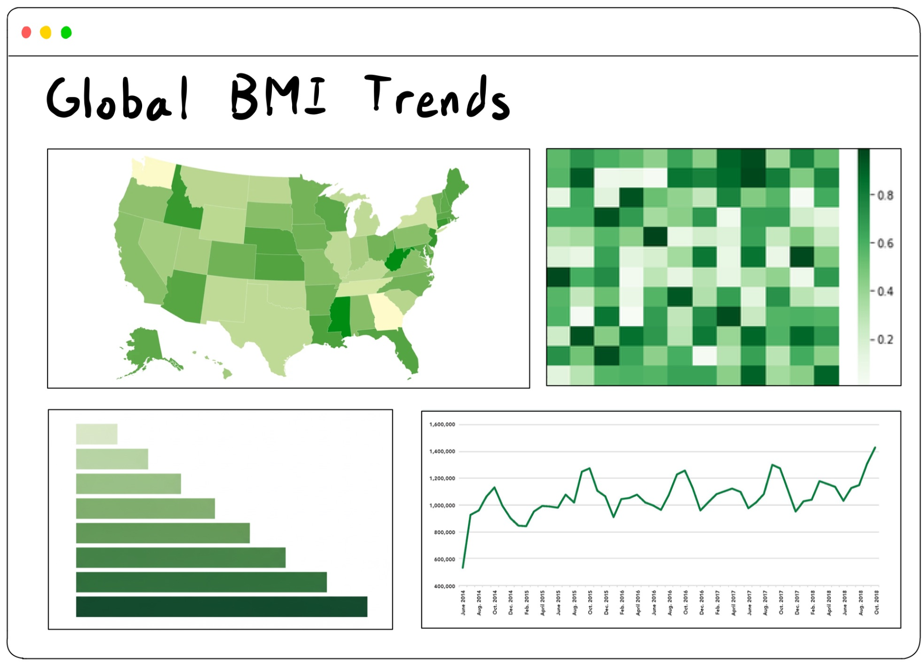
Methods: Sample

Slide 22

Thank You
Questions, comments concerns?

